Slide 1



Slide 2



01CE0503 - Design and Analysis of Algorithm
Unit - 3
Divide and Conquer
Prof. Jaydeep K. Ratanpara
Computer Engineering Department

Slide 3



OUTLINE
Introduction
Problem Solving using divide and conquer algorithm
Binary Search
Multiplying large Integers Problem,
Sorting Algorithms (Merge Sort , Quick Sort)
Max-Min problem
Matrix Multiplication
Exponential

Slide 4
INTRODUCTION
A divide and conquer is a strategy of solving a large problem by
Divide: Divide the given problem into sub-problems using recursion.
Conquer: Solve the smaller sub-problems recursively. If the sub problem is small enough, then solve it directly.
Combine: Combine the solutions of the sub-problems that are part of the
recursive process to solve the actual problem.

Slide 5
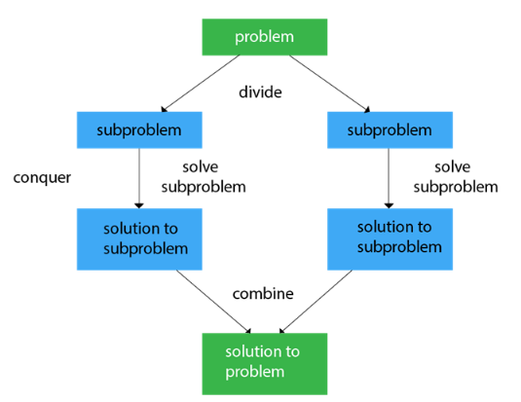
INTRODUCTION

Slide 6
BINARY SEARCH
Binary search is used to search the particular element in the list.
If the element is present in the list, then the process is called successful, and the process returns the location of that element. Otherwise, the search is called unsuccessful.
Binary search follows the divide and conquer approach in which the list is divided into two halves, and the item is compared with the middle element of the list.
If the match is found then, the location of the middle element is returned. Otherwise, we search into either of the halves depending upon the result produced through the match.
Note: Binary search can be implemented on sorted array elements. If the list elements are not arranged in a sorted manner, we have first to sort them.

Slide 7




BINARY SEARCH
int bs(int arr[ ], int l, int h, int key)
{
if (l <= h)
{
int mid = (l + h) / 2;
if (arr[mid] == key)
return mid;
if (key<arr[mid])
return bs(arr, l, mid - 1, key);
else
return bs(arr, mid + 1, h, key);
}
return -1;
}

Slide 8
Multiplying large Integers Problem
This problem can be solved with the help of divide and conquer technique.
For example: consider multiplication of two integers 42 and 34.
First let us represent these numbers according to positions.

Slide 9
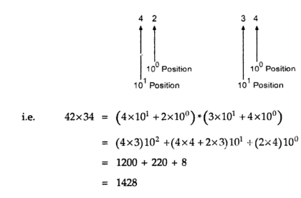
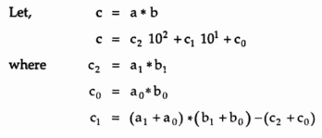
Multiplying large Integers Problem

Slide 10
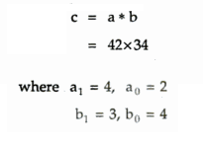
Multiplying large Integers Problem

Slide 11
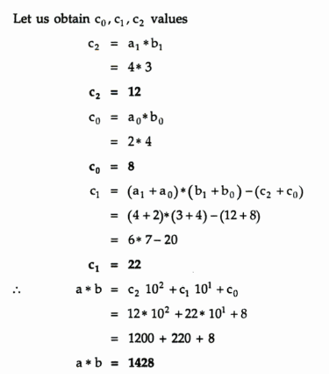
Multiplying large Integers Problem

Slide 12
Multiplying large Integers Problem
We can generalize this formula as-
If size of integer is n digit, then we can generalize multiplication as,
C=a*b
C = c₂10^{n} + c₁10^{n/2} + c₀
Where,
c₂ = a₁ * b₁
c₀ = a₀*b₀
c₁ = (a₁ + a₀) * (b₁ + b₀) – (c₂ + c₀)
This can be solved by applying recursion till n reaches to 1.

Slide 13
MERGE SORT
Merge sort is yet another sorting algorithm that falls under the category of Divide and Conquer technique. It is one of the best sorting techniques that successfully build a recursive algorithm.
It works by recursively dividing the array into two equal halves, then sort them and combine them.

Slide 14
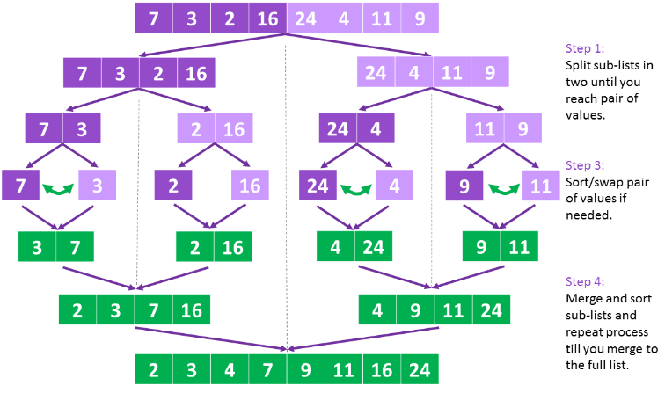
MERGE SORT

Slide 15
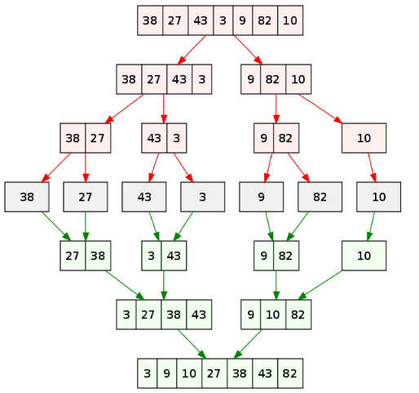
MERGE SORT

Slide 16
MERGE SORT
Algorithm MS(A[0..n-1],low, high)
{
If(low<high) then
{
mid = (low+high)/2
MS(A,low,mid)
MS(A, mid+1, high)
Combine(A,low,mid,high)
}

Slide 17
MERGE SORT
Algorithm combine(A,low,mid,high)
{
k ← low
i ← low
j ← mid+1
while ( i <= mid and j <= high) do
{
if(A[ i ] <= A[ j ] ) then
{
temp[ k ]←A[ i ]
i++
k++
}
else
{
temp[ k ]=A[ j ]
j++
k++
}
}

Slide 18
MERGE SORT
//copy left sub list
while ( i <= mid) do
{
temp[ k ]←A[ i ]
i++
k++
}
//copy right sub list
while ( j <= high) do
{
temp[ k ]←A[ j ]
j++
k++
}

Slide 19
QUICK SORT
Quick sort is a fast sorting algorithm used to sort a list of elements.
The quick sort algorithm attempts to separate the list of elements into two parts and then sort each part recursively. That means it use divide and conquer strategy.
In quick sort, the partition of the list is performed based on the element called pivot.
Here pivot element is one of the elements in the list.
The list is divided into two partitions such that "all elements to the left of pivot are smaller than the pivot and all elements to the right of pivot are greater than or equal to the pivot".

Slide 20
QUICK SORT
In Quick sort algorithm, partitioning of the list is performed using following steps...
Step 1 - Consider the first element of the list as pivot (i.e., Element at first position in the list).
Step 2 - Define two variables i and j. Set i and j to first and last elements of the list respectively.
Step 3 - Increment i until pivot >= A[i] then stop.
Step 4 - Decrement j until pivot<= A[j] then stop.
Step 5 - If i < j then exchange A[i] and A[j].
Step 6 - Repeat steps 3,4 & 5 until i > j.
Step 7 - Exchange the pivot element with A[j] element.

Slide 21


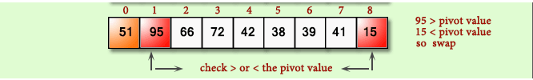

QUICK SORT

Slide 22



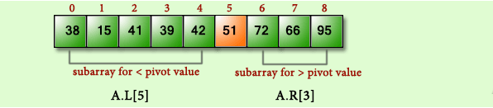
QUICK SORT

Slide 23
QUICK SORT
void quickSort(int arr[ ], int low, int high)
{
if (low < high)
{
int pivot = partition(arr, low, high);
quickSort(arr, low, pivot - 1);
quickSort(arr, pivot + 1, high);
}
}
int partition(int arr[ ], int low, int high)
{
int i = low;
int j = high;
int pivot = arr[low];
while (i < j)
{
while (pivot >= arr[i])
i++;
while (pivot < arr[j])
j--;
if (i < j)
swap(arr[i], arr[j]);
}
swap(arr[low], arr[j]);
return j;
}

